Slide 1

Works vs. Works
Hebrews 11:6

Slide 2
Hebrews 11:6 (NASB 1995)
And without faith it is impossible to please Him, for he who comes to God must believe that He is and that He is a rewarder of those who seek Him.

Slide 3
The religious community today disagrees and argues over the need for works in order to inherit salvation. This is a major misconception that people have. The thought process of doing no work goes hand in hand with the lie of “once saved, always saved”.

Slide 4
These same people are quick to quote the writings of Paul, yet will discount the writings of James, Jesus’ earthly half-brother. Oddly enough, both James and Paul draw their examples from Abraham.

Slide 5
How is it that two New Testament writers both being inspired by the Holy Spirit draw conflicting accounts of works? In reality, the two writers compliment one another if we keep their writings in context.

Slide 6
The Greek word used by both Paul and James in our lesson today is ergon (er-gon) from the primary word ergo
– to work;
– toil as an effort or occupation.

Slide 7
Works of Merit

Slide 8
Ephesians 2:8-9 (NASB 1995)
⁸ For by grace you have been saved through faith; and that not of yourselves, it is the gift of God;
⁹ not as a result of works, so that no one may boast.

Slide 9
2 Timothy 1:8-9 (NASB 1995)
⁸ Therefore do not be ashamed of the testimony of our Lord or of me His prisoner, but join with me in suffering for the gospel according to the power of God,

Slide 10
2 Timothy 1:8-9 (NASB 1995)
⁹ who has saved us and called us with a holy calling, not according to our works, but according to His own purpose and grace which was granted us in Christ Jesus from all eternity,

Slide 11
Romans 4:4-5 (NASB 1995)
⁴ Now to the one who works, his wage is not credited as a favor, but as what is due.
⁵ But to the one who does not work, but believes in Him who justifies the ungodly, his faith is credited as righteousness,

Slide 12
Jeremiah 1:15-16 (NASB 1995)
¹⁵ For, behold, I am calling all the families of the kingdoms of the north,” declares the Lord; “and they will come and they will set each one his throne at the entrance of the gates of Jerusalem, and against all its walls round about and against all the cities of Judah.

Slide 13
Jeremiah 1:15-16 (NASB 1995)
¹⁶ I will pronounce My judgments on them concerning all their wickedness, whereby they have forsaken Me and have offered sacrifices to other gods, and worshiped the works of their own hands.

Slide 14
Works of Faith
Notes:
Will Gossett ~ July 26, 2026 (Eloy AM)

Slide 15
Philippians 2:12-13 (NASB 1995)
¹² So then, my beloved, just as you have always obeyed, not as in my presence only, but now much more in my absence, work out your salvation with fear and trembling;
¹³ for it is God who is at work in you, both to will and to work for His good pleasure.

Slide 16
Work – katergazomai (kat-er-gad-zom-ahee)
– do work fully
– accomplish
– to finish, fashion work

Slide 17
Colossians 3:23-24 (NASB 1995)
²³ Whatever you do, do your work heartily, as for the Lord rather than for men,
²⁴ knowing that from the Lord you will receive the reward of the inheritance. It is the Lord Christ whom you serve.

Slide 18
James 2:14-26 (NASB 1995)
¹⁴ What use is it, my brethren, if someone says he has faith but he has no works? Can that faith save him?
¹⁵ If a brother or sister is without clothing and in need of daily food,

Slide 19
James 2:14-26 (NASB 1995)
¹⁶ and one of you says to them, “Go in peace, be warmed and be filled,” and yet you do not give them what is necessary for their body, what use is that?

Slide 20
James 2:14-26 (NASB 1995)
¹⁷ Even so faith, if it has no works, is dead, being by itself.
¹⁸ But someone may well say, “You have faith and I have works;

Slide 21
James 2:14-26 (NASB 1995)
show me your faith without the works, and I will show you my faith by my works.”
¹⁹ You believe that God is one. You do well; the demons also believe, and shudder.

Slide 22
James 2:14-26 (NASB 1995)
²⁰ But are you willing to recognize, you foolish fellow, that faith without works is useless?

Slide 23
James 2:14-26 (NASB 1995)
²¹ Was not Abraham our father justified by works when he offered up Isaac his son on the altar?
²² You see that faith was working with his works, and as a result of the works, faith was perfected;

Slide 24
James 2:14-26 (NASB 1995)
²³ and the Scripture was fulfilled which says, “And Abraham believed God, and it was reckoned to him as righteousness,” and he was called the friend of God.

Slide 25
James 2:14-26 (NASB 1995)
²⁴ You see that a man is justified by works and not by faith alone. ²⁵ In the same way, was not Rahab the harlot also justified by works when she received the messengers and sent them out by another way?

Slide 26
James 2:14-26 (NASB 1995)
²⁶ For just as the body without the spirit is dead, so also faith without works is dead.

Slide 27
Joshua 6:15-16 (NASB 1995)
¹⁵ Then on the seventh day they rose early at the dawning of the day and marched around the city in the same manner seven times; only on that day they marched around the city seven times.

Slide 28
Joshua 6:15-16 (NASB 1995)
¹⁶ At the seventh time, when the priests blew the trumpets, Joshua said to the people, “Shout! For the Lord has given you the city.

Slide 29
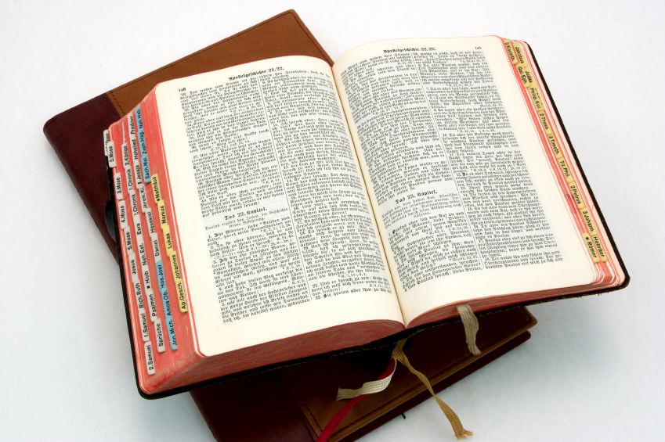
Hear: Romans 10:17
So then faith cometh by hearing, and hearing by the word of God.

Slide 30
Believe: Hebrews 11:6
But without faith it is impossible to please him: for he that cometh to God must believe that he is, and that he is a rewarder of them that diligently seek him.

Slide 31
Repent: Luke 13:3
I tell you, Nay: but, except ye repent, ye shall all likewise perish.

Slide 32
Confess: Matthew 10:32-33
32 Whosoever therefore shall confess me before men, him will I confess also before my Father which is in heaven.
33 But whosoever shall deny me before men, him will I also deny before my Father which is in heaven.

Slide 33
Baptize: Acts 22:16
And now why tarriest thou? arise, and be baptized, and wash away thy sins, calling on the name of the Lord.

